Slide 1
Self Driving car sim
End to end behavior transfer Deep learning

Slide 2

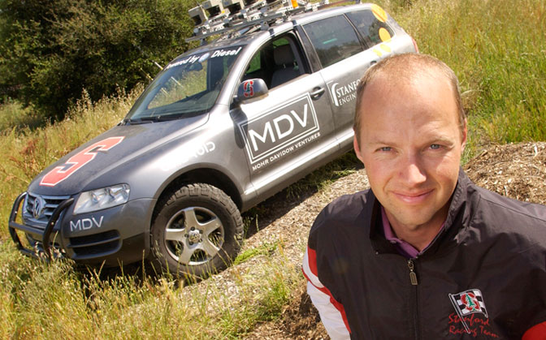
Background
Udacity Self Driving Car Engineer NanoDegree
3 Terms, each about 4 months long.
Term 1 – Machine Learning and Computer Vision with Python
Term 2 – Sensor Fusion and Controls in C++
Term 3 – Path Planning, Functional Safety and Advanced Topics
Udacity, and this course, created by Dr. Sebastian Thrun, who lead the team that won the DARPA autonomous vehicle challenge while a professor at Stanford.
Dr. Thrun went on to start the Google Self-Driving Car program
Completion of each term is dependent on completion of 5 projects.
Project 3 from Term 1 is discussed here

Slide 3
Term 1, Project 3 – Self Driving car sim
In this project, use camera and steering data collected in the simulator, to successfully drive a car around the track.
An example of “End to End Behavior Transfer using Deep Learning”
“End to End” because there is no intermediate code between the input (looking at the road) and the output (commanding a steer angle); we are asking the neural network to learn the entire task.
“Behavior Transfer” because the data which the network trains on is generated by human control of a car driving around in the simulator.
“Deep Learning” is a generic term for multi-stage neural networks. The “depth” can vary greatly…
Link to YouTube demo video: https://www.youtube.com/watch?v=mqJgwtfJ_68&t=176s
Link to GitHub: https://github.com/danbergeland/sdc/tree/master/P3-BehaviorCloneSubmission

Slide 4
Deep learning & Neural networks
Most important area of research in Computer Science today!
First conceived of in the 60’s with the mathematical concept of perceptrons… from cat brains
This field has exploded since 2012,
AlexNet smashed the ImageNet challenge
27% error in 2011 using CV techniques to 16% error with AlexNet using Deep Learning
It’s now a viable technology because of relatively inexpensive parallel processor units.
Nvidia CUDA cores! It totally justifies buying expensive graphics cards.
Tensorflow 1.0 is now available for Windows!
Google supported. Open-source. GPU accelerated with CUDA.
Windows version 1.0 released March 9th. Rev 0.18 was available in December 2016.
Best resource to learn about Neural Networks: Stanford CS231n Winter 2016 class.

Slide 5
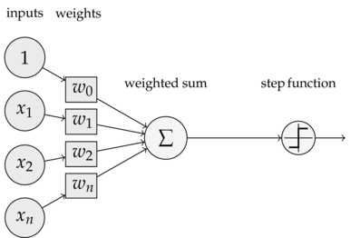
Simple neural network
Shown below is a “Fully Connected” or “Dense” node in a network
Inputs on the left are multiplied by weights
The weighted inputs are summed at the node
Changing the weights changes the output!
A threshold, or non-linear function is introduced to pass on data to the next layer
General design concepts:
The weights and inputs should be normalized to less than 1 and 0 mean.
“Step Function” is called an Activation – ReLU, Leaky ReLU, tan, threshold
Once the weights are trained, we only need to feed data forward through the net
Linear algebra / matrix multiplication and addition. Very Fast!

Slide 6
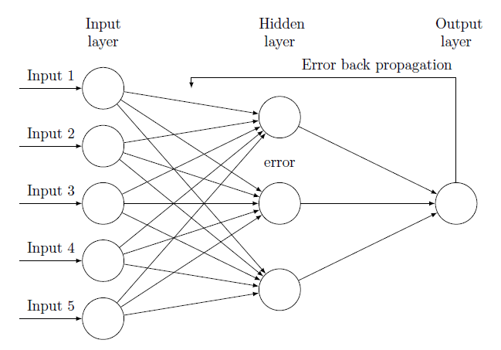
Training Neural networks
All current methods use “Back propagation” to update weights
In backprop, the weights are adjusted based on their contribution to the error.
The error in this project is the difference between the steering angle the network predicted and the “label” for the image, which is what the human was steering at that moment.
Iterate thousands or millions of times during some training with small learning rates. BRUTE FORCE TUNING!

Slide 7
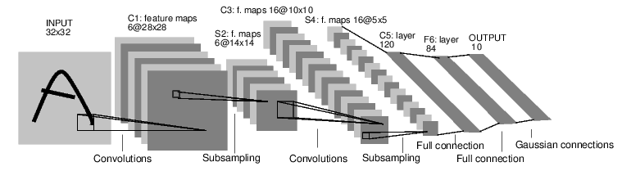
Convolutional neural networks (CNN)
Input is an image, in this case
Each layer is built of filters” or “kernels”, which look at groups of pixels
The next layer values are based on how well the filters match the input data
Kernels are small, relative to the input image
My project used a 64x64 image with 3x3 pixel kernel size on the first 3 layers.
We need a lot of kernels. The kernels learn shapes like lines and color transitions, so you need 5 or 6 just to identify the edges of a stop sign!
The weights of the kernels are trained, so it learns which shapes to find
LeNet, in all its glory!

Slide 8
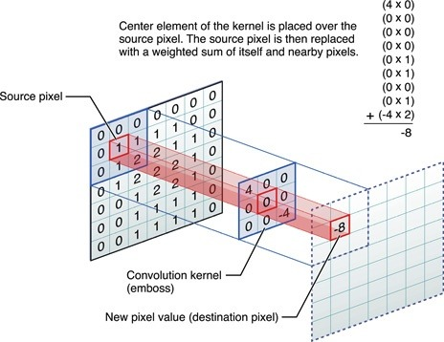
I don’t get it…
For this 3x3 filter, the output will be a single number
This output value represents how well the filter matches the input pixels
Filters can be thought of as learned feature shapes
A high number would indicate the feature matched well
A negative number would indicate there’s no chance the feature matched
Use many filters, each with their own set of weights

Slide 9
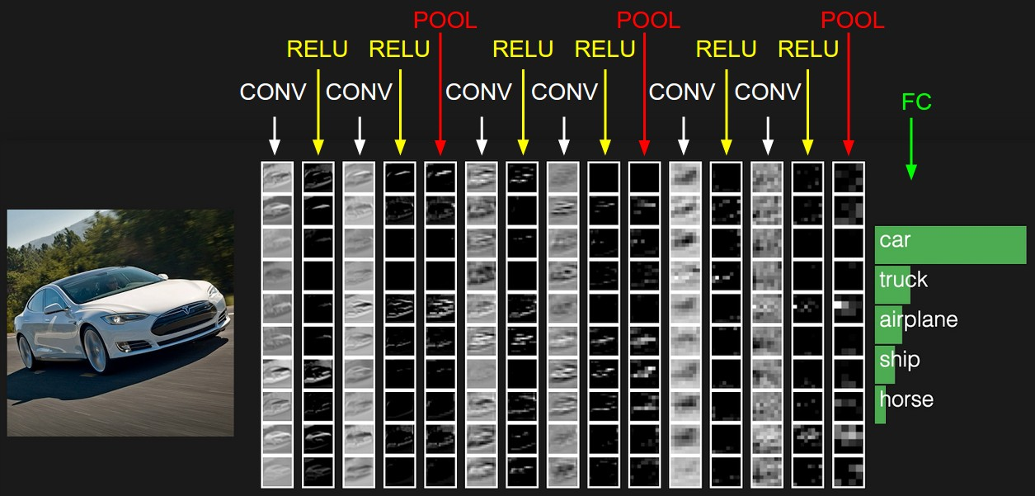
Visualizing the filter outputs
As the image goes through the network, the resolution goes down (it looks less and less like a car)
the convolutions begin to represent things like ‘wheel’, ‘headlight’ or ‘tree’, deeper networks allow for more combinations of these shapes.
The classification output of this network is probably based on “2 wheels, 2 headlights, flat surfaces”, instead of any individual pixels.

Slide 10
Which network do we want?
There are 2 categories of network outputs: Classification and Regression.
This network trains for regression, so we have a single output at the end.
Since we are driving, we need to look all over the image for the roadway and the edge of the roadways.
Convolutional neural networks allow the filters to look at all parts of the image.
As a side note, there are 3 main categories of Machine Learning:
Supervised Learning – Data is labeled (which is this project)
Unsupervised Learning – Let the algorithm form labels and grouping
Reinforcement Learning – Explore and Exploit, Evolutionary
This project is an example of “Supervised Learning” for a “Regression” problem.

Slide 11


Let’s build it – code tools
Python 3
The ‘do-it-all’ interpreted language
Anaconda
Controls virtual environments, provides prebuilt binaries for the virtual env.
Jupyter Notebook – Modular development of Python code
OpenCV
open-source computer vision library
Crop, color, shade, convert color space, visualize outputs
Keras with Tensorflow
Architect, train, save and load neural networks for deep learning
Ubuntu Linux

Slide 12
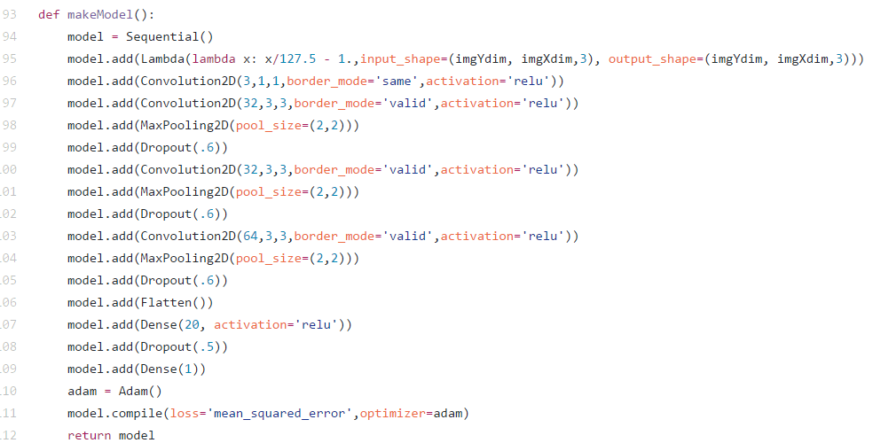
Get The Net!
I used 4 convolution layers, with 2 fully connected layers
Approximately 70k parameters. The recommended architecture for the project contained 2M params, and some students were successful with as few as 64 params.
20 Lines of code

Slide 13
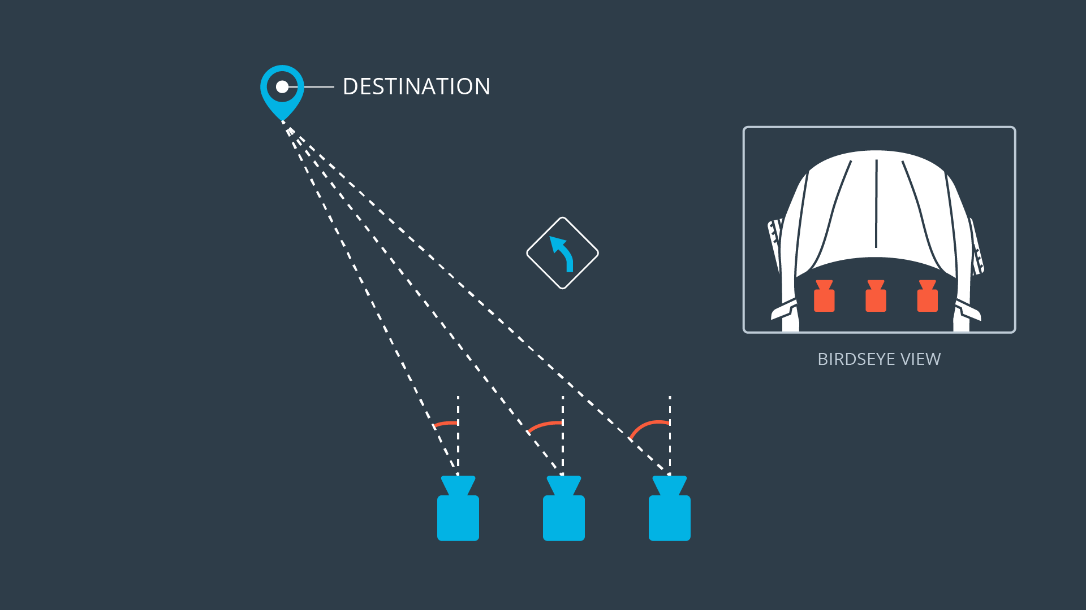
Collecting data
The simulator has cameras on the car. There’s an option in the simulator to “record”, and it will take images for each camera.
The steering angle and throttle is also recorded with each image in a CSV file. The CSV entries contain the paths to the images and the steering/throttle measurements.
Only the center camera is available during automatic driving, so why the side cameras?

Slide 14
Using Side Camera Data
Since the side cameras were off center, they were given artificial steering angles.
My generator that feeds images and steering data into the network for training added steering angle offsets to the left and right images to teach it that it should go back to the middle of the lane.
Keras uses generators for the training process. This is code that allows for preprocessing and selecting only the images you want to use for training. The training process will get small batches of images (50 – 300), which is what allows you to train on massive data sets without running out of memory or waiting all day for hard drives.

Slide 15
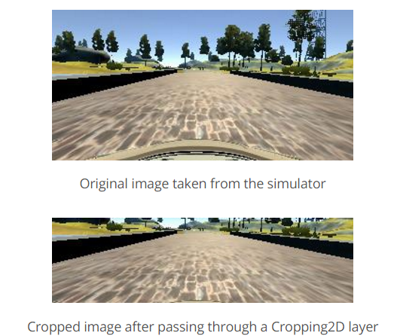
Training considerations
Most of this project was understanding how training data affects network performance. THE NETWORK CAN ONLY LEARN FROM WHAT IT SEES.
Cropping the image
Remove parts of the image that don’t affect steering (sky, trees, dashboard)

Slide 16
Training considerations
Distribution of turn angles
Proportion of training images with low turn angles vs. high turn angles
Left and Right turns
Image Color Space – RGB => HSV
Hue and Saturation channels are more consistent on road ways
Lightening and darkening of images to prevent over-fitting
Resizing the image
A smaller input size reduces the size of the entire network (default image size was 1280 x 720). Even with GPU acceleration, going from full size to 64x64 pixels takes a training epoch from a few minutes down to 30 seconds. Squeezing dimensions also affects performance (wide to square).

Slide 17
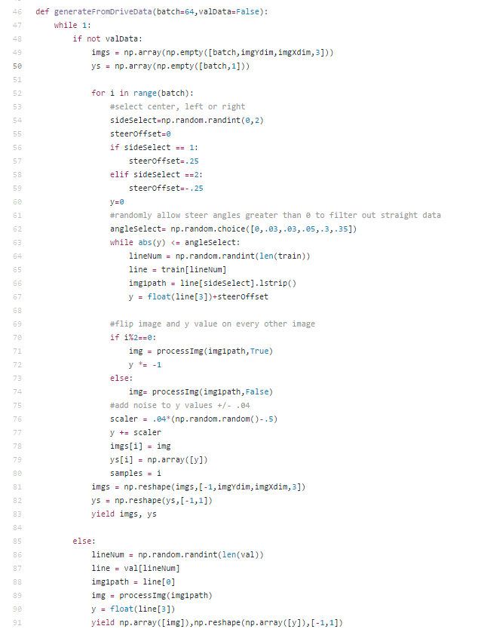
the generator
45 Lines of Code
Returns batches of images with labels, 64 by default
Adds steering offsets for side images
Filters out low turn angles
Flips images so the car can turn left AND right
Adds noise to the steering label
Resizes the image to the input of the network

Slide 18
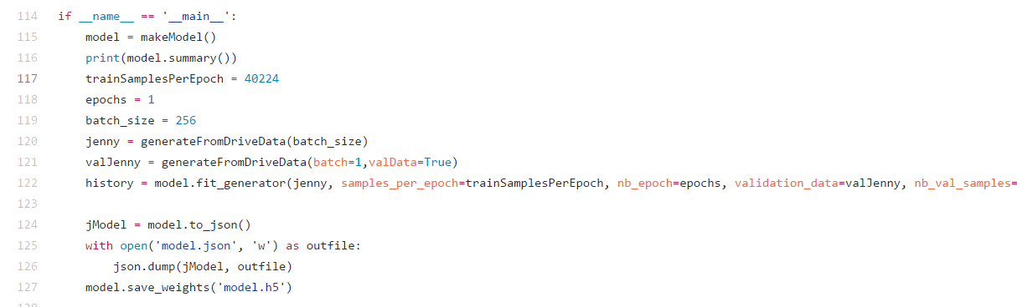
Training code
Defining architecture and using a generator reduces the code base size
Trained for 1 epoch of 40k samples (training set is ~8k images)
Total length of code is 127 lines to train and save the weights.
I easily spent over 40 hours on this project, including research time
Very time consuming because of the guess and check nature of poorly defined skills (like driving) and training times.
Tested performance by loading the simulator and watching it drive

Slide 19
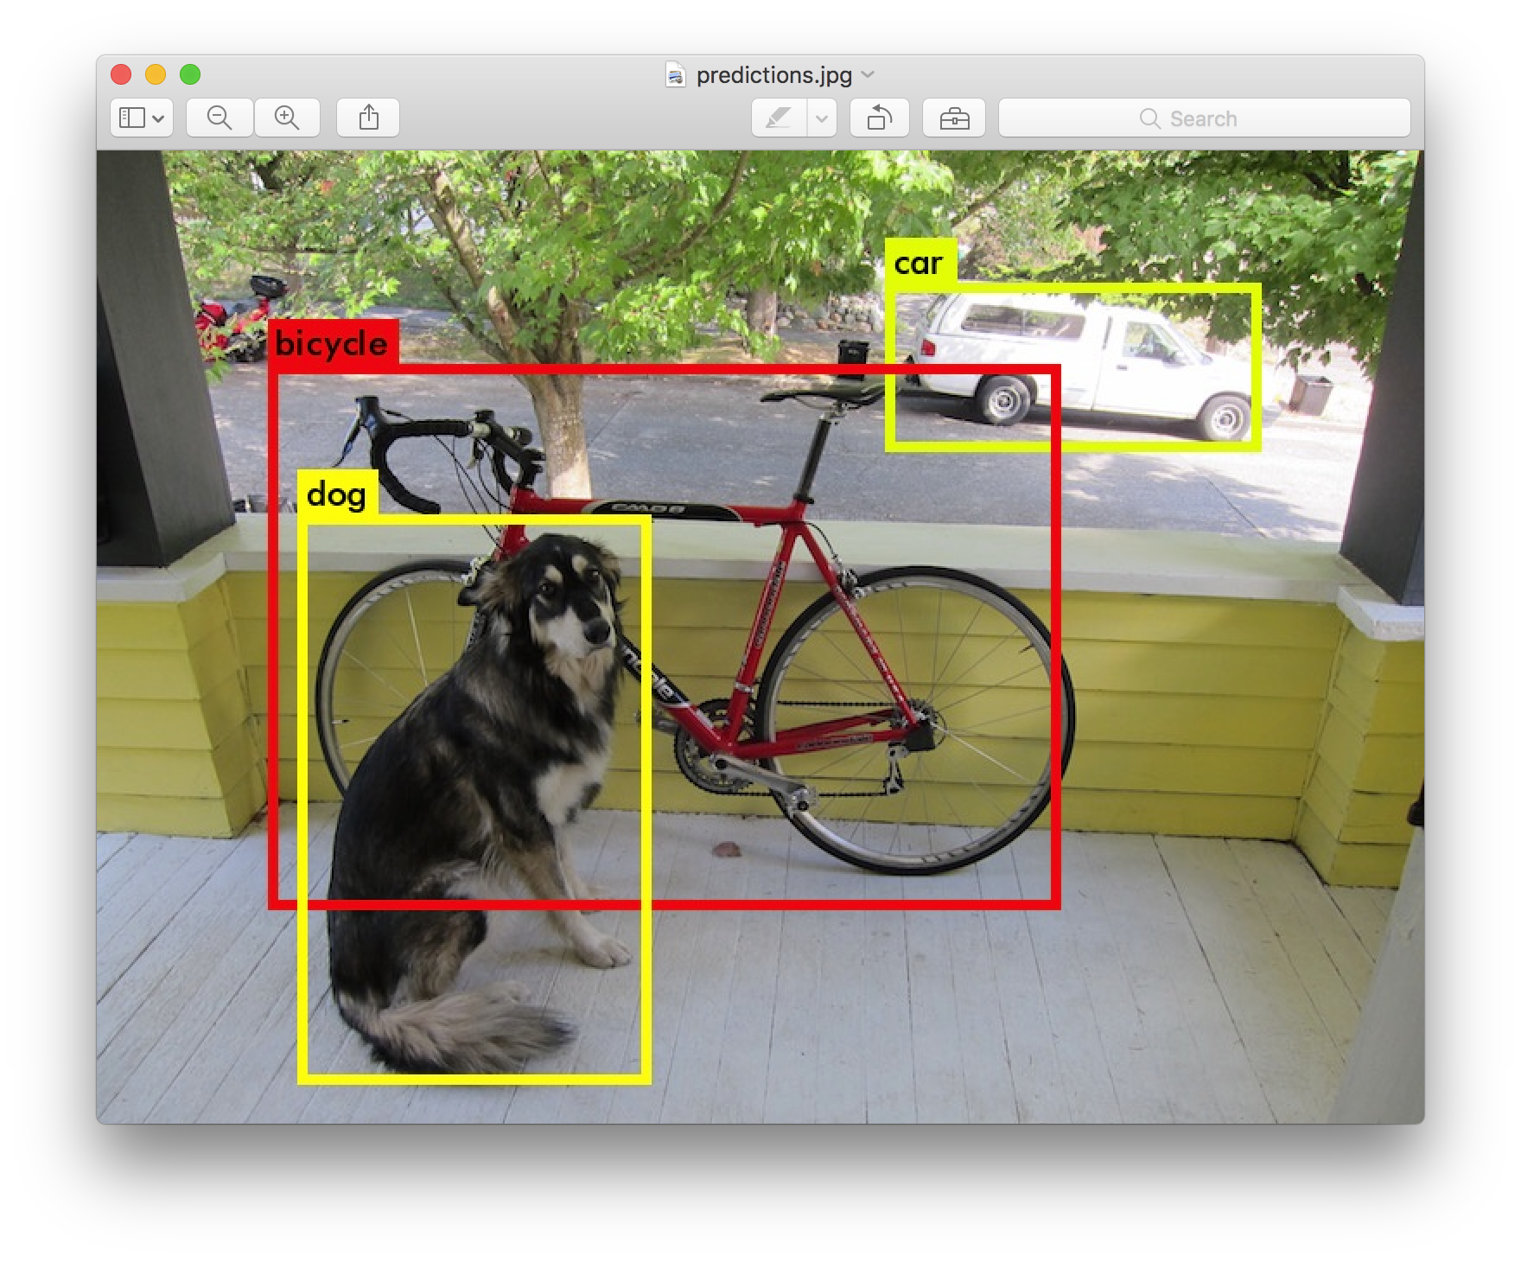
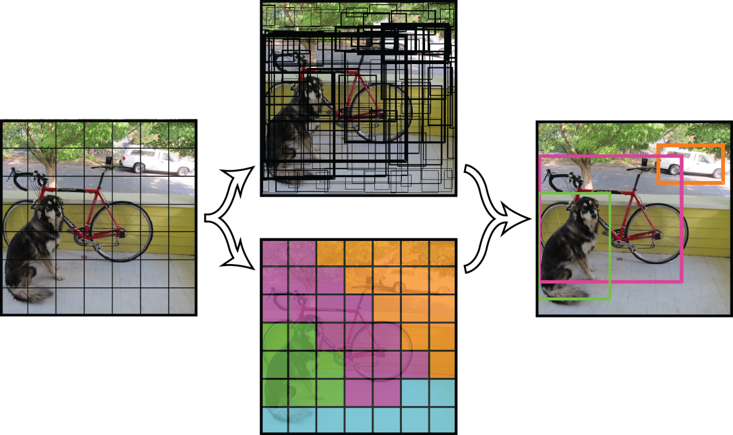
Exciting topics in machine learning
Localization and Classification – Identifying where things are and what they are
YOLO – You only look once. Solving Classification, and Localization as Regression!
-Incredibly fast and just as accurate as other approaches
-Open Source, so free to use and comes with pre-trained DarkNet weights

Slide 20
